Slide 1
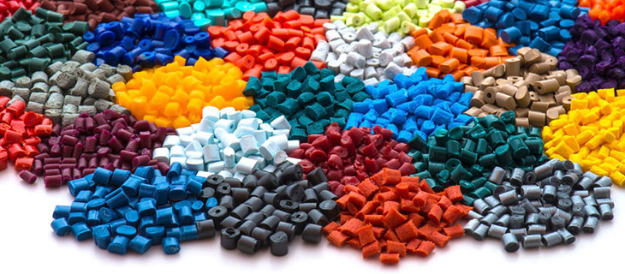
higher Design & Manufacture
Plastic Processes

Slide 2


Learning intentions & success criteria
Learning Intentions
To develop an understanding of the processes involved in the manufacture of plastics.
Success Criteria
I can name 3 commonly used plastic manufacturing processes.
Give examples of the different plastic opperations.

Slide 3
Manufacturing processes
To be a success in the marketplace products must have certain attributes:
The product must function as intended.
The product must look good.
The product must be cost effective.
The product is able to be manufactured.
A team approach will be used, where all members will be aware of the demands of manufacturing and the relative costs involved.
This approach means that cost effective decisions can be made and necessary changes to the design and manufacture of a product can be made in the early stages of design.

Slide 4
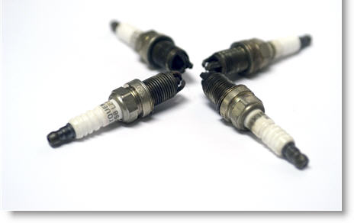
standardisation
Components, materials and production procedures all have to be costed prior to beginning manufacture.
Standardisation of these things will cut down on costs and can then be applied to more than one product at a time.
A car is a good example of this, some parts can be used across a range of cars
  e.g. VW, Audi, Seat and Skoda all
  share parts with various models

Slide 5
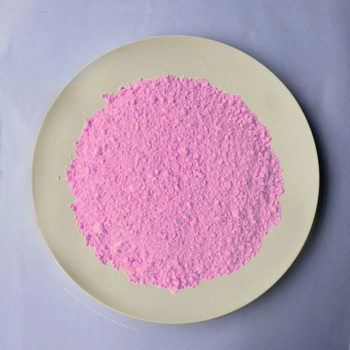
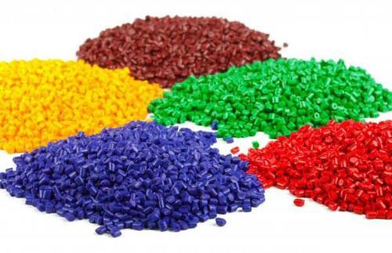
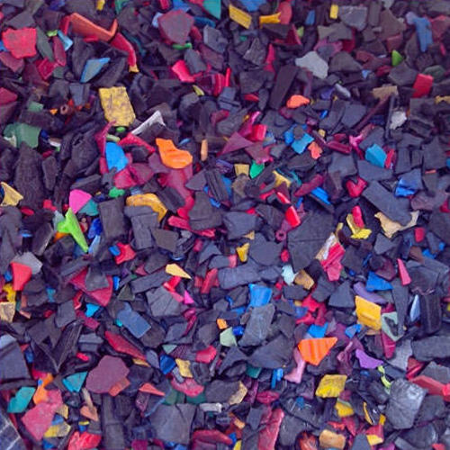
Plastic processes
Plastics are usually supplied as:
  Moulding powder
  Granules
  Chips
…which have to be processed.
Processing includes the thorough mixing of additives to allow a relatively small base of plastics to be transformed into a wide range or versatile materials.

Slide 6
Plastic processes cont.
Reforming Processes
  Injection Moulding
  Rotational Moulding
  Blow Moulding
  Extrusion
Deforming Processes
  Vacuum Forming
  Compression Moulding
  Line Bending

Slide 7
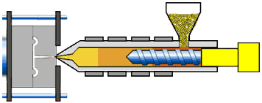
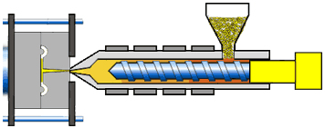
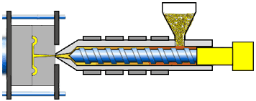
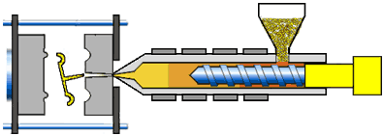
Injection Mouding
Molten thermoplastic is injected into a mould.
It then cools.
The mould is opened and the component is released.
Due to the high pressure, the component can be very complex.
Uses:
  everyday plastic items e.g. containers, toys,
Limitations:
  Size: tends to be for smaller components
  Several small components joined together using a ‘sprue’ to connect the individual molds on one runner.

Slide 8
Injection Moulding.
Advantages
  Good for intricate parts
  High repeatability
  Low cost per part
  Fast process
  Little plastic waste
  Disadvantages
    High initial cost
    Long initial lead time
    Limitations on larger parts
    Careful design required

Slide 9
INJECTION MOULDING
Design of moulded components:
  Minimise amount of plastic to avoid environmental impact
  Cycle time of moulding process (more can be made in a given period and high cost of mould manufacture can be paid off quicker).

Slide 10
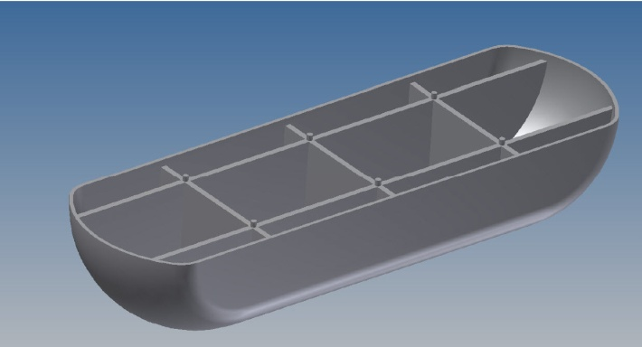
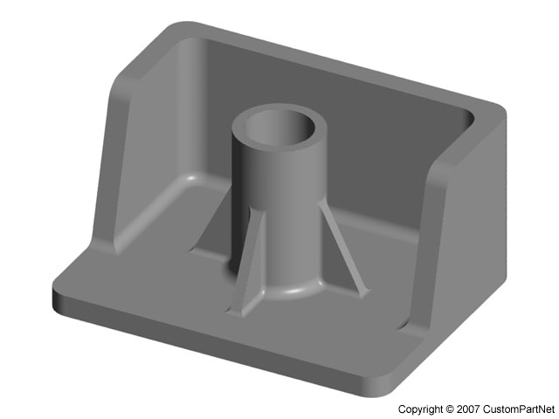
Injection moulding
Wall Thicknesses
  Thick walls use large amounts of plastic
  Take longer to cool
  Reducing wall thickness to minimum amount required for strength reduces the amount of plastic and speeds up the process
  Ribs can give rigidity and strength to thin walls
  Bosses (a common feature in housings where components are screwed together) can have their wall thicknesses reduced using webs.

Slide 11
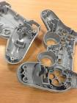
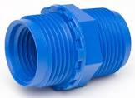

Injection moulding
Thick walls use large amounts of plastic
  Location pins (Used to ensure the accurate position of the workpiece)
  Symmetrical and asymmetrical design
  Labelling
  Moulded threads

Slide 12
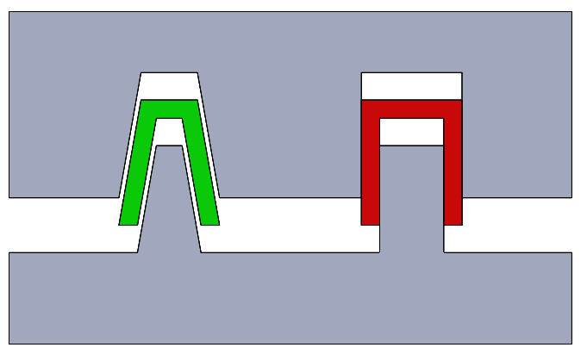
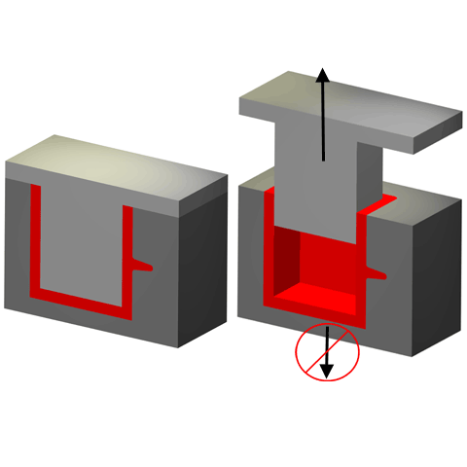
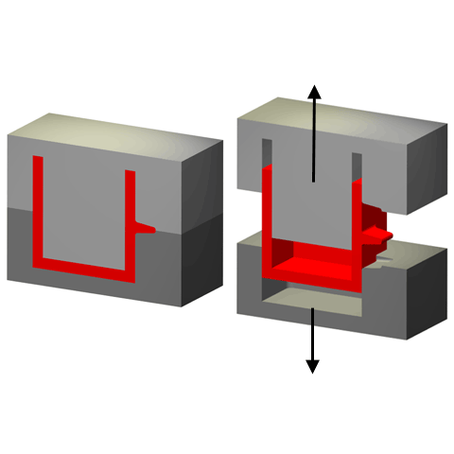
Injection moulding
Removal of Mould
  The newly moulded component must be removed from the mould
  A draft angle reduces the amount of friction
Undercuts
  Can prevent the component from being removed from the mould.
  Careful positioning of the split line can solve this
  Sliding cores can be added but are more complex
Reduction of Component Numbers
  Due to the complexity of injection moulding, several components can be combined
  Thus, one mould is required, not many
  Saves time
  Video: https://www.youtube.com/watch?v=C3oiy9eekzk (1:34)

Slide 13
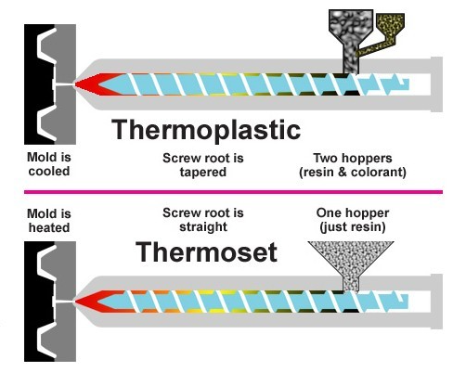
Thermoset Injection moulding
In thermoset injection moulding cold material is injected into an extremely hot mould to create the part.
Not as common a process, except with electrical contact applications.
Thermoset injection moulding is most frequently used where the part has to withstand high temperatures.
Thermoset process is typically slower- which equates to a higher cost.
Thermosetting plastics can not be re-melted, therefore there recycling factor is limited

Slide 14
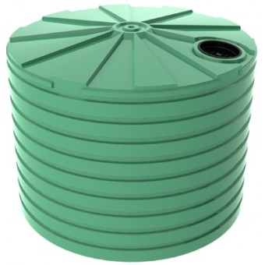
Rotational Moulding
Creates medium to large sizes hollow components
Involves melting plastic in a closed mould which is rotated so the plastic coats the inside of the mould
The plastic is cooled and solidifies into the shape of the mould
Examples:
  Storage bins
  Water tanks
  Flotation devices

Slide 15
Rotational Moulding
Secondary operations (such as drilling, punching or cutting) can be used to make holes in the component
Can also separate parts e.g. lid of a bin
Where components require trapped air, rotational moulding is better-suited as there are no areas of weakness or gaps for air to escape
What plastics are used?
  Polyethelene (LDPE, HDPE) is the most common
  Polypropylene
  Plasticised PVC
  Polycarbonate

Slide 16
Rotational Moulding
Advantages:
  larger sizes can be made compared to injection moulding
  Low pressure means less split lines
  No sprue injection point marks
  Low pressure means moulds can be made from fibreglass or wood compared to metal
Disadvantages:
  Not possible to vary wall thicknesses
  Cycle time is much slower due to time of heating and cooling

Slide 17
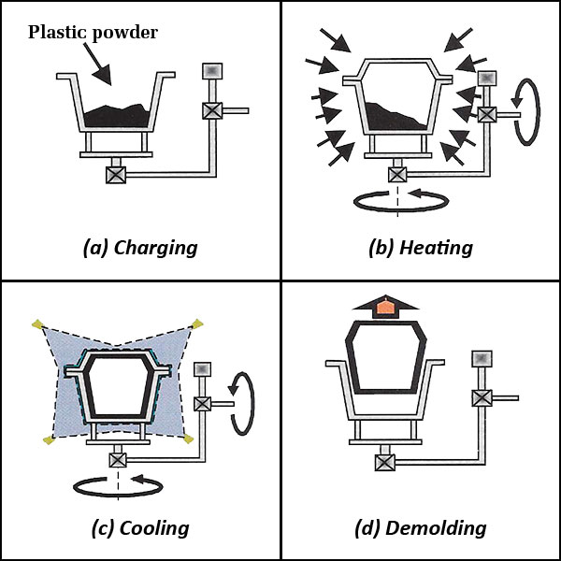
Rotational Moulding
Process:
  Stage 1
    Plastic graduals are placed inside a mould
    This mould is then sealed
  Stage 2
    Mould is heated in a large oven
    The mould begins to rotate
    Melted plastic coats the inside of the mould
  Stage 3
    Mould is removed from the oven and cooled
    Mould continues to rotate as plastic solidifies
  Stage 4
    The mould is opened and the component is removed
  Video: https://www.youtube.com/watch?v=q2xE-VfAjmE

Slide 18
Blow moulding
Uses compressed air to expand softened plastic tube into the shape of the mould
Hollow objects with holes at an end e.g. bottles
Depending on the size, blow moulding may have to be changed to rotational moulding
Production speed is quicker with blow moulding for high volumes of components required
Uses thermoplastics
  E.g. Low density polyethylene (LDPE) for plastic bottles (good impact strength and flexible, good resistance to chemicals
  High density polyethylene (HDPE) similar to LDPE but less flexible

Slide 19
Blow moulding
Advantages:
  Fast process
  Suitable for mass production
  Automated process
  Complex shapes
  Thickness of walls can be closely controlled
Disadvantages
  Moulds can be expensive
  Not suitable for larger objects where rotational moulding would replace the process

Slide 20
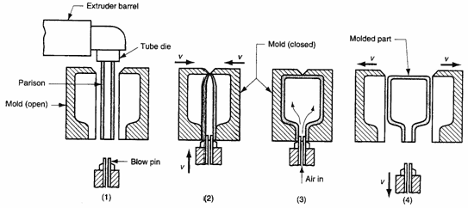
Blow moulding
The process example: plastic bottle
  Step A
    A parison (extruded hollow tube) of soft plastic is fed into the open moulds
    Usually done vertically
  Step B
    Two mould halves are closed, pinching off one end of the parison and leaving an inlet tube at the other
  Step C
    Compressed air is blown n
    The air expands the parison like a balloon until it meets the outside of the mould
  Step D
    The plastic cools
    The mould is opened
    The plastic bottle is removed
Video: https://www.youtube.com/watch?v=8W6P5KU5ONQ

Slide 21
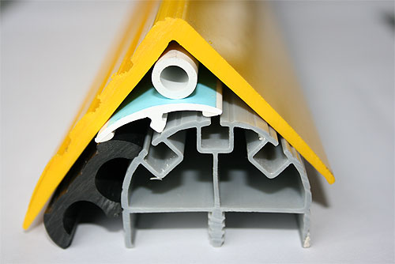
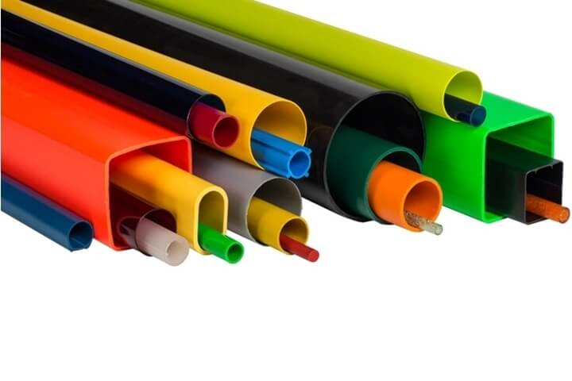
extrusion
Molten plastic is pushed through a shaped hole
As it passes through the hole, it cools and solidifies
Components with long, continuous profiles
  E.g. tubes, rods, shaped bars
  E.g. guttering, pipes, window frames etc.
Thermoplastics are extruded
  E.g. PVC (polyvinyl chloride) can withstand UV light and deterioration

Slide 22
extrusion
Advantages
  Cross section of components can be very complex
  Allows for hollow components with varying wall thicknesses (good for strength etc)
  Reinforcing walls can be added to save the amount of plastic required, saving material and cost
  Doesn’t leave marks as it is pushed through a hole compared to injection, blow moulding etc
  Is a continuous process
  Any desired length can be achieved
  Dimensions can be accurately controlled (components can be made to fit snugly together)
  Variety of colours available and same components can be made in multiple colours

Slide 23
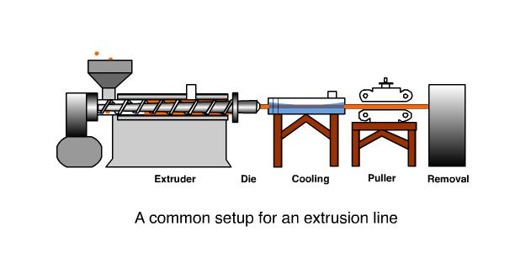
extrusion
The process:
  Stage A
    Plastic granules are fed into a hopper
  Stage B
    Granules are moved along a heated chamber by a screw.
    As they are heated, they melt
  Stage C
    Molten plastic is pushed through a shaped hole in a die
  Stage D
    The cooled plastic is now in the shape of the hole
    It is then cut to length
    Video: https://www.youtube.com/watch?v=wE_KTLlrdMA

Slide 24
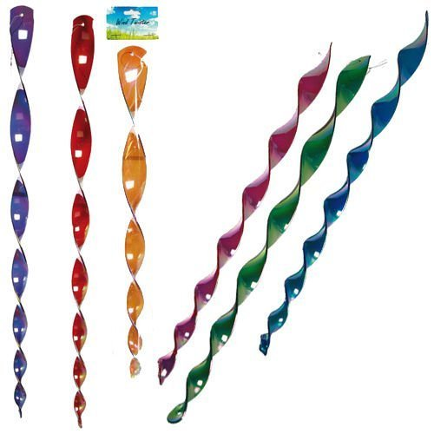
thermoforming
Thermoforming involves heating a sheet or strip of thermoplastic until it softens
It is then pressed into a shape using a former
The sheet cools and hardens in its new shape
Thermoforming also includes heating a strip or sheet of plastic in an oven and pressing the softened sheet between two formers or bending it round a former
The plastic strip can also be twisted
More complex shapes can be made

Slide 25
thermoforming
Example products:
  Curved display stand
  Twisted wind sculptures
  Any items with complex curves
Thermoforming uses thermoplastics
  E.g. acrylic is commonly used
Advantages:
  Complex shapes
  Sheets can be cut to shape
  Holes can be cut from them before being place in the oven
  Easier to cut shapes from a flat sheet rather than curved
Disadvantages
  Size of ovens limit size of sheets
  Handling of large, hot plastic sheets can be problematic

Slide 26
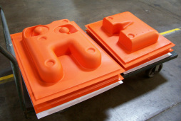
Vacuum forming
Process uses air pressure to deform a heated and softened thermoplastic sheet
Example products:
  Masks, trays, body armour, plastic casings, bathtubs, yoghurt pots etc
Types of plastic used
  ABS – scratch resistant and tough
  HIPS – cheap, tough, low softening temperature
  Acrylic – strong and scratch resistant
  PVC – clear, rigid, difficult to rip

Slide 27
Vacuum forming
Advantages
  Formers are cheap to manufacture
  Formers can be made from plywood, aluminium, making it cheaper than injection moulding
Disadvantages
  Restrictions to shapes
  You cannot have undercuts
  Formers must be carefully designed to ensure the thermoplastics can take the required shape and can be removed once cooled and hardened

Slide 28
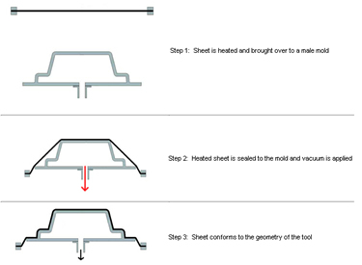
Vacuum forming
The Process
  Stage A
    The former is placed inside a chamber, resting on a platen (moveable platform with small holes in it which will allow air to flow through it)
    The chamber is sealed by clamping a sheet of thermoplastic over the top of the chamber
    A heater heats the thermoplastic until it softens
  Stage B
    The heater is removed and the platen is raised so that the former pushes against the underside of the thermoplastic sheet
  Stage C
    A vacuum pump sucks the air out of the chamber
    Air pressure outside the chamber pushes the softened plastic sheet onto the former
    When the sheet is cooled, the platen is lowered and the sheet is unclamped and removed
    Excess plastic is trimmed using a craft knife or abrasive disc

Slide 29
Vacuum forming
Former Design
  Well designed formers will allow the thermoplastic to accurately reproduce the shape required
  Evacuation holes allow air to escape ensuring the plastic can take the shape of the former
  Rounded edges will stop the former punching through the soft thermoplastic
  Draft angles (the former being smaller at the top than at the bottom) and a smooth surface will ensure the plastic can be easily removed
  No large changes in height will ensure the plastic will not be stretched too thinly
Videos: https://www.youtube.com/watch?v=VyIBsmoiqqs
https://www.youtube.com/watch?v=GbuwHDNONaM&t=2s

Slide 30
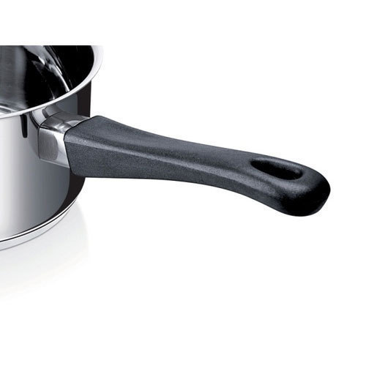
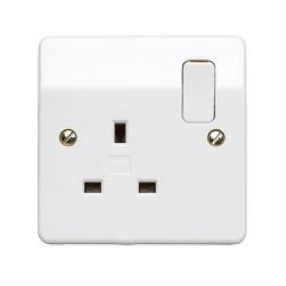
Compression moulding
Compression moulding allows plastics to be squeezed into the shape of a mould
Examples:
  Components which have a fairly complicated shape
  E.g. Shoe soles, pan handles, electrical sockets
Suitable for thermosetting plastics
  With the ability to withstand heat and scratches
Plastics used:
  Malamine Formaldehyde (good scratch resistance, ability to be produced in a variety of colours) – for example, children’s dinner plates

Slide 31
Compression moulding
Advantages
  Can be used for thermosetting plastics (which could not be used in injection moulding for example)
  Compression moulding can be carried out in a two stage process
    First layer can be cooled and an additional layer can be added without damaging the first layer)
Disadvantages
  Leaves a flash which must be trimmed off

Slide 32
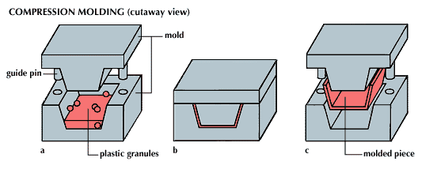
Compression moulding
The Process
  Stage A
    A pre-heated slug is placed in the bottom part of the mould
  Stage B
    A hydraulic press closes the mould and squeezes the slug into shape
    The mould halves are heated to allow the plastic to flow
    Excess plastic squeezes out of the mould cavity
    This excess plastic is called ‘flash’
  Stage C
    The mould is opened and the component removed
    Flash is removed using a scraper or blade knife

Slide 33
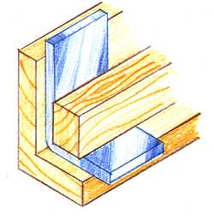
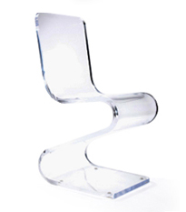
Line bending
Line bending uses a strip heater to heat and soften a thermoplastic sheet
The sheet can then be folded into shape and will retain that shape once it has cooled
To get the required shape, a former is used
  The former is a shaped block which will ensure that he angle that the plastic is to be folded to is correct

Slide 34
Line bending
Uses thermoplastics, since they can be heated and softened
  E.g. acrylic is a common plastic used
Advantages:
  Very simple process
  Strip heater is inexpensive
  Formers are cheap to produce
  Cheap process
Disadvantages
  Limited shapes as they can only be bended in straight lines
  Difficult or near impossible to produce curved bends
Video: https://www.youtube.com/watch?v=CbwbYqVq5Po

Slide 35
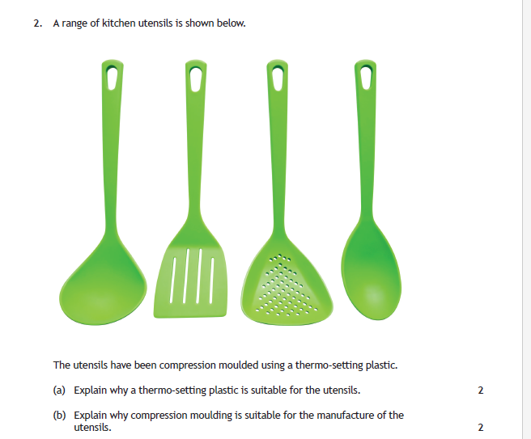
Past paper question

Slide 36
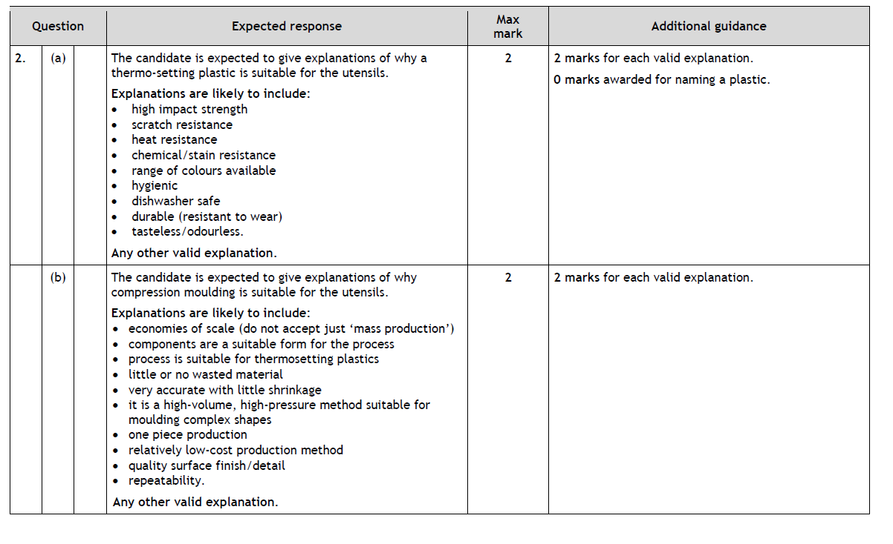
Past paper answers

